Slide 1
Optimization Algorithms for Neural Networks
By,
Ruthvik Raja M.V & Shilpa Shankar

Slide 2



* Introduction
* Optimization Algorithms
Gradient Descent (GD)
Stochastic Gradient Descent (SGD)
Mini-batch SGD
SGD with Momentum
AdaGrad
AdaDelta & RMSProp
Adam
* Conclusion
Today's
Agenda

Slide 3

Introduction:-
Neural networks is a subset of Machine Learning in which Neural networks adapt and learn from vast amounts of data.
The Neuron is the building block of a Neural network that takes some input, does some mathematical computation by multiplying the input values with their corresponding random weights and finally produces the output.

Slide 4
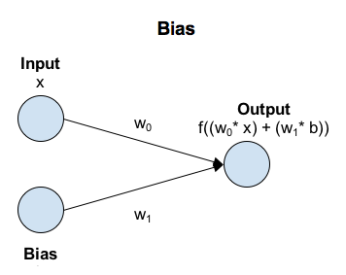
Each node (Hidden and Output layers) in a Neural network is composed of two functions, namely linear and activation function. In the forward propagation, the Linear function is computed by summation of multiplying previously connected nodes output and corresponding weight, bias as shown in the Figure.
After applying the Linear function, Activation functions like Sigmoid, Relu, Leaky Relu, Parametric Relu, Swish Relu, Softplus AF’s etc are implemented based on the problem type and requirement.

Slide 5
Role of an Optimizer:-
After computing the output at the output layer, the predicted value is compared with the actual value by computing Loss.
The Loss function is used to determine the error between the actual and predicted value. The Optimization algorithm is used to determine the new weight values i.e Loss w.r.t change in weights to bring the output of the next trial closer to the actual output.

Slide 6
Epoch and Iteration:-
Epoch describes the number of times the algorithm sees the entire dataset.
Iteration describes the number of times a batch of data passed through the algorithm.
For example, consider the input dataset consists of 10,000 records and if we train the model for 10 epochs, let the batch size = 1 i.e loading each data point every time and performing forward, backward propagation for every data point. Hence, the number of iterations per epoch for the above example would be 10,000 and the number of epochs would be 10.

Slide 7


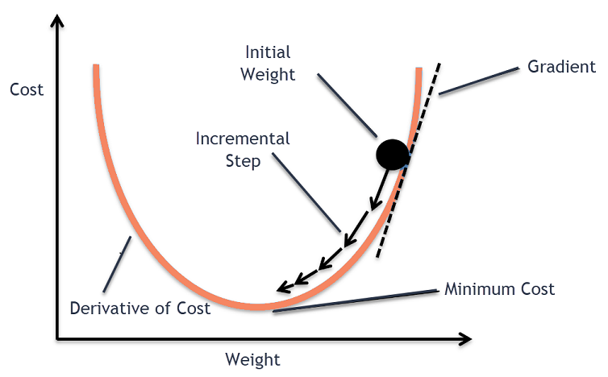

Gradient Descent:-
The formula to compute new weights using Gradient Descent is as follows:-
The formula to compute Loss using Gradient Descent is as follows:-

Slide 8
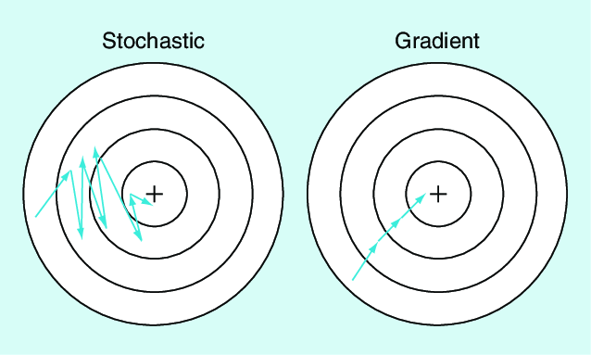
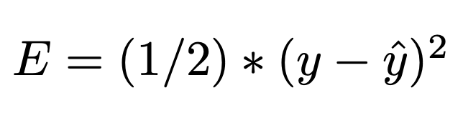
Stochastic Gradient Descent:-
The formula to compute new weights using Stochastic Gradient Descent is as follows:-
The formula to compute Loss using Stochastic Gradient Descent is as follows:-

Slide 9
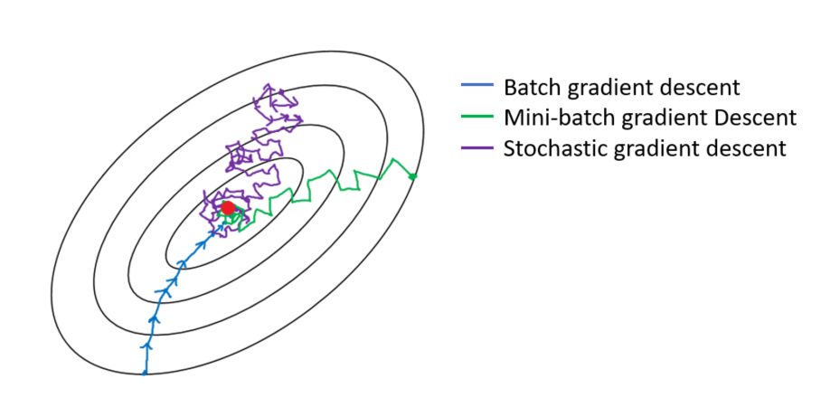
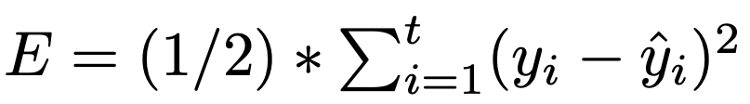
Mini-Batch Stochastic Gradient Descent:-
The formula to compute new weights using Mini-Batch Stochastic Gradient Descent is as follows:-
The formula to compute Loss using Mini-Batch Stochastic Gradient Descent is as follows:-

Slide 10
Overall Comparison (GD (vs) SGD (vs) Mini-Batch SGD):-
Algorithm | Logic for every Iteration
GD | Considers whole Data-Set
SGD | Considers 1 Data-Point
Mini-Batch SGD | Considers a Batch of Data-Points

Slide 11

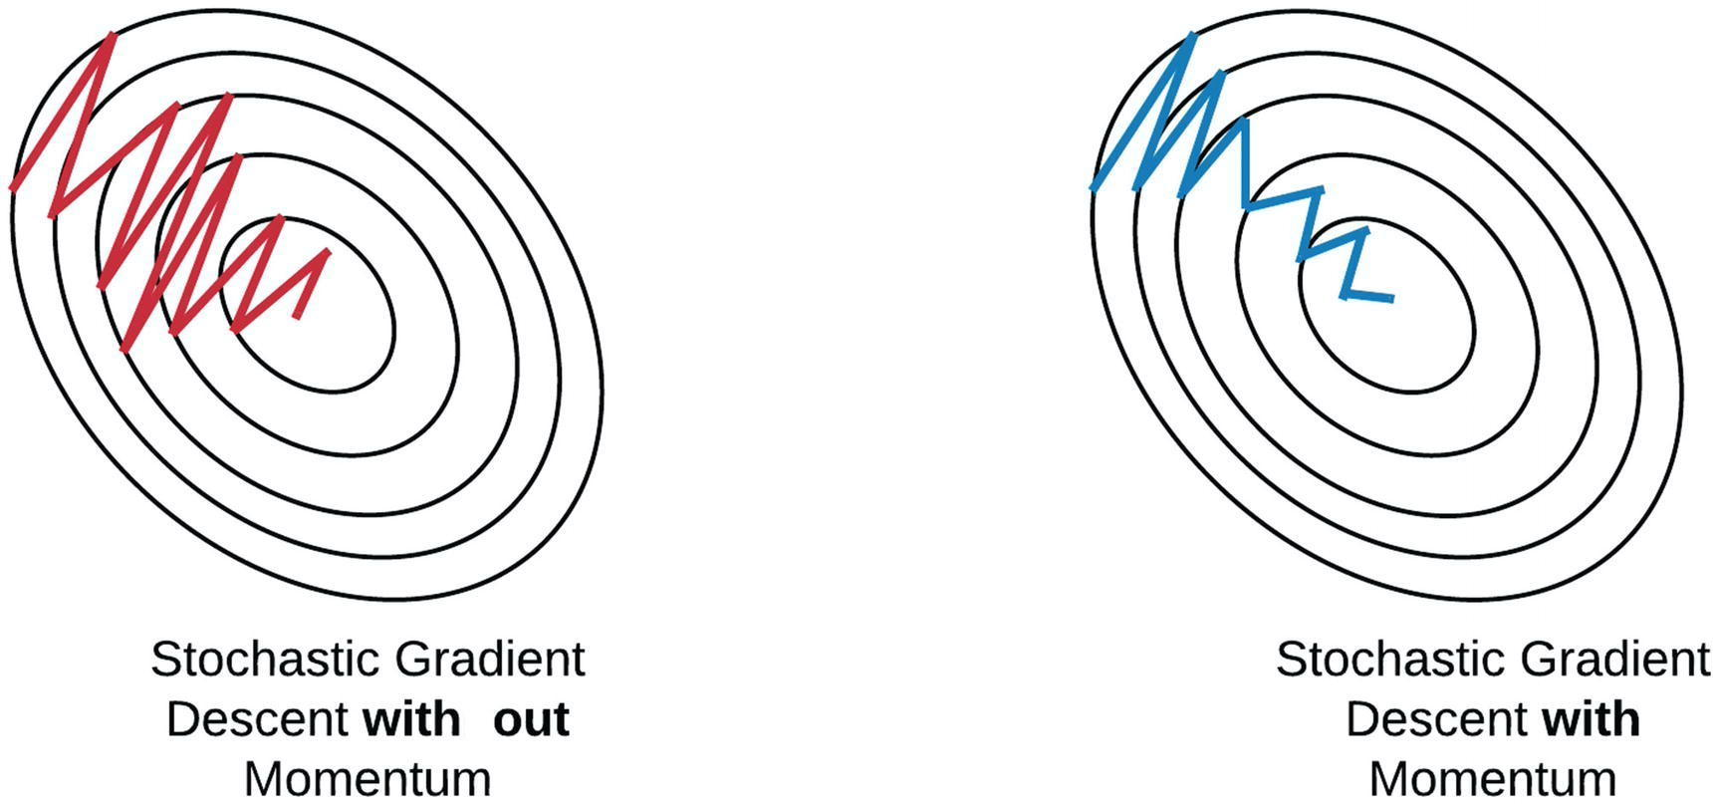
Stochastic Gradient Descent with Momentum:-
The formula to compute new weights using Stochastic Gradient Descent with Momentum is as follows:-
The formula to compute Loss using Stochastic Gradient Descent with Momentum is as follows:-

Slide 12
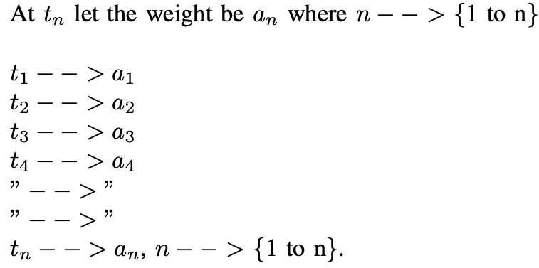
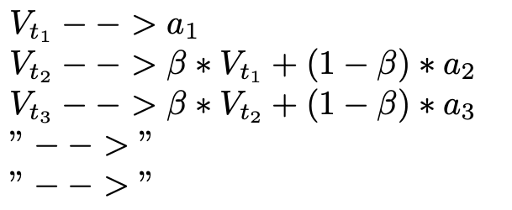
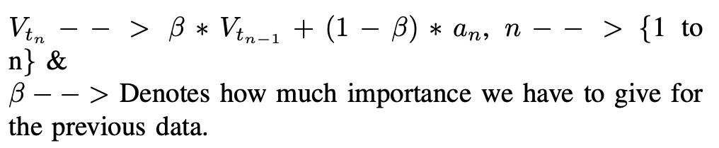
For better illustration, consider the following scenario to calculate Exponential Weighted Average:-

Slide 13
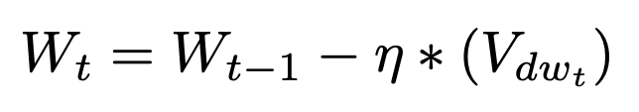


Therefore, the final updated formulae to calculate new weights & bias are as follows:-
where,

Slide 14

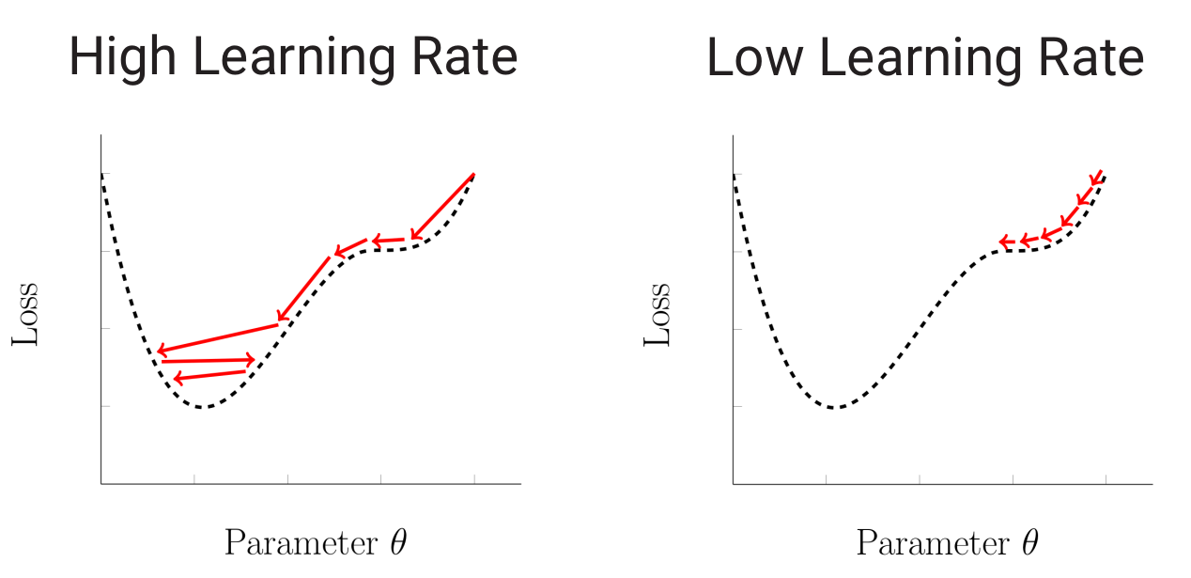
Adaptive Gradient Descent:-
The formula to compute new weights using Adaptive Gradient Descent is as follows:-
The formula to compute Loss using Adaptive Gradient Descent is as follows:-

Slide 15

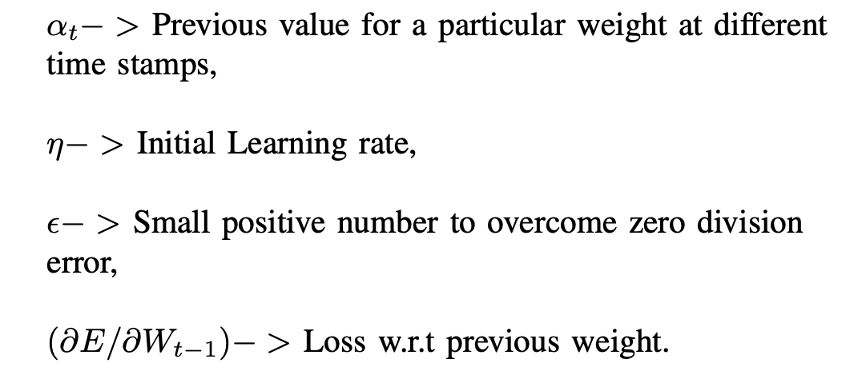
where,

Slide 16
Adaptive Learning Rate Method & Root Mean Squared Propagation:-
The formula to compute new weights using AdaDelta & RMSProp is as follows:-
The formula to compute Loss using AdaDelta & RMSProp is as follows:-

Slide 17
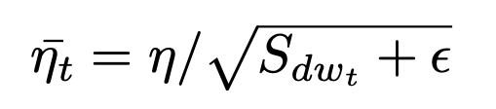


where,

Slide 18
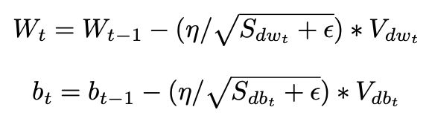
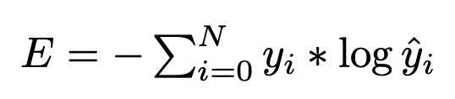
Adaptive Moment Estimation:-
The formulae to compute new weights & bias using Adam are as follows:-
The formulae to compute Loss for Regression & Classification problems using Adam are as follows:-

Slide 19
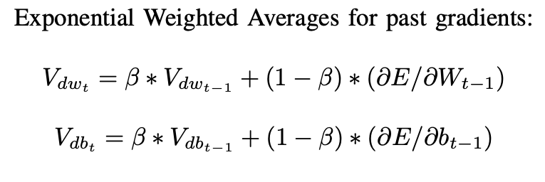
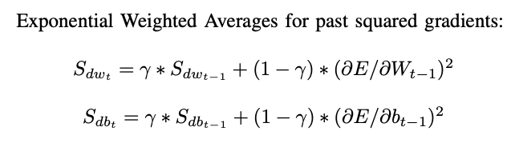
where,

Slide 20
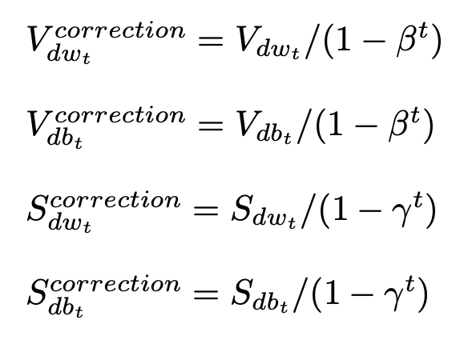
When utilising Exponential Weighted Averages, there is a process known as bias correction. Scientists have introduced Bias correction to get better results at the initial time stamps. Therefore, the formulae for Bias correction is as follows:-

Slide 21
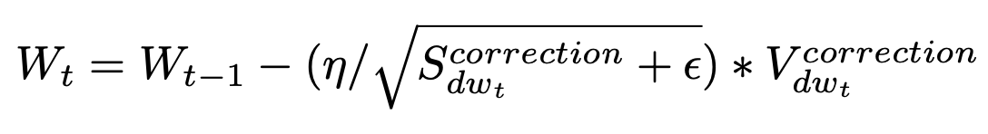
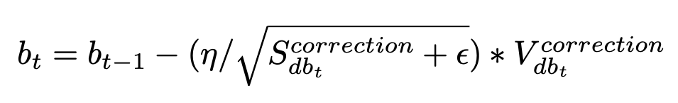
The updated Weight & Bias formulae are as follows:-

Slide 22
Conclusion:-
In this Presentation, different Optimization algorithms that are available in the field of Artificial Intelligence were discussed in detail to reduce the Loss function of a Neural Network.
Overall, Adam Optimizer is comparatively better than other algorithms because it was implemented using some advanced theories.
However, there is no guarantee that the Adam optimizer will outperform all the given datasets because it depends on several other features like the type of problem, size of the input data, number of features, etc.
Gradient Descent and SGD algorithm work well for small datasets, Mini-batch SGD, SGD with Momentum & RMSProp can be tried on large datasets.

Slide 23


